Slide 1
Outline
Qwerty-Bounded Keyboard Layout Optimization
Multilingual Keyboard Layout Optimization
Keyboard Layout Optimization for Gesture Typing
Multi-Objective Optimization for Decoding Algorithm
[Bi, Ouyang, Zhai. Both Complete and Correct? Multi-Objective Optimization of
Touchscreen Keyboard. ACM CHI 2014]

Slide 2
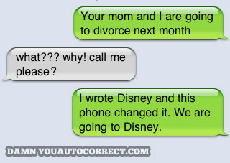
Unsuccessful Auto-correction

Slide 3
Unsuccessful Auto-correction

Slide 4
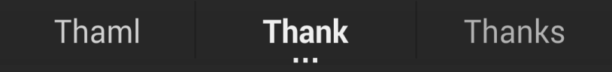
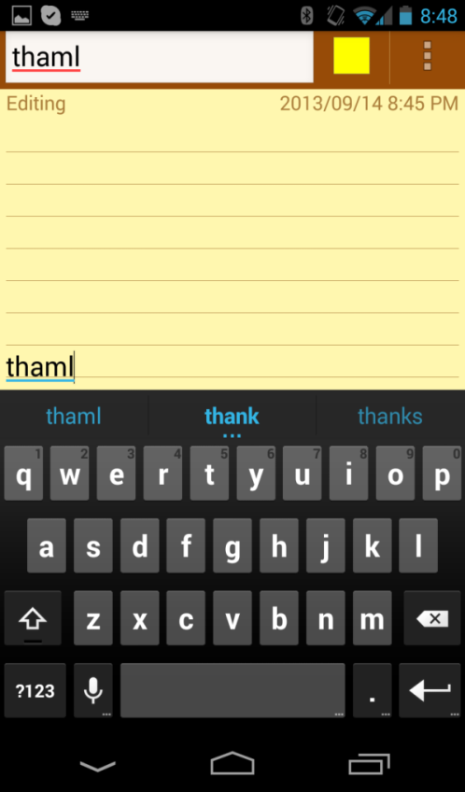
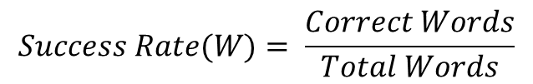
Modern Touchscreen Keyboard
Correction
Thaml
Thank
$$Success Rate(W)= \frac{Correct Words}{Total Words}$$

Slide 5
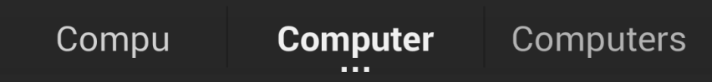
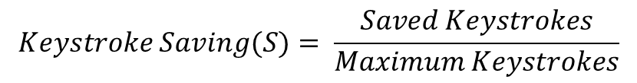
Modern Touchscreen Keyboard
Correction
Completion
Thaml
Thank
Compu
Computer
$$Success Rate(W)= \frac{Correct Words}{Total Words}$$
$$Keystroke Saving(S)= \frac{Saved Keystrokes}{Maximum Keystrokes}$$

Slide 6
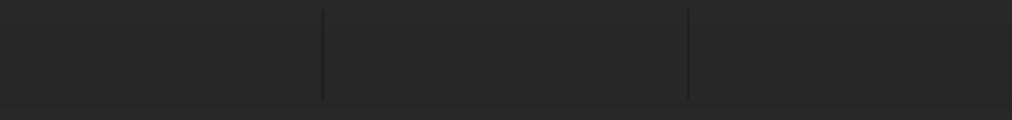
Correction vs. Completion
fac
Notes:
170, 000 english words, 26⁵ = 12, 000, 000

Slide 7
Correction vs. Completion
fax
fac
Notes:
170, 000 english words, 26⁵ = 12, 000, 000

Slide 8
Correction vs. Completion
fax
fac
facilitate
Notes:
170, 000 english words, 26⁵ = 12, 000, 000

Slide 9
Correction vs. Completion
fax
fac
facilitate
?
Relationship between Correction and Completion
Notes:
170, 000 english words, 26⁵ = 12, 000, 000

Slide 10
Correction vs. Completion
3 Possible Relationships

Slide 11
Correction vs. Completion
3 Possible Relationships
Completion
Correction

Slide 12
Correction vs. Completion
3 Possible Relationships
Completion
Completion
Correction
Correction

Slide 13
Correction vs. Completion
3 Possible Relationships
Completion
Completion
Completion
Correction
Correction
Correction

Slide 14
Correction vs. Completion
?
3 Possible Relationships
Completion
Completion
Completion
Correction
Correction
Correction

Slide 15




Android Open Source Project (AOSP) Keyboard
word
user
Touch Points
$$s_{1}, s_{2}, …,s_{n}$$
Keyboard Decoding
Algorithm
$$w_{i}$$
$$w_{i}$$

Slide 16
Android Open Source Project (AOSP) Keyboard
word
user
Touch Points
$$s_{1}, s_{2}, …,s_{n}$$
Keyboard Decoding
Algorithm
$$w_{i}$$
$$w_{i}$$
Adjustable Parameters

Slide 17
Android Open Source Project (AOSP) Keyboard
word
user
Touch Points
$$s_{1}, s_{2}, …,s_{n}$$
Keyboard Decoding
Algorithm
$$w_{i}$$
$$w_{i}$$
Adjustable Parameters
E.g., COST_LOOKAHEAD : cost of unseen letters

Slide 18
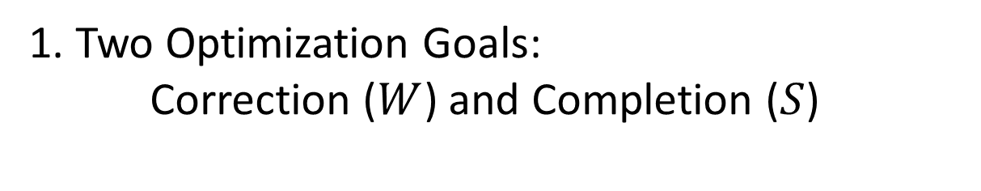
Multi-Objective Optimization of Keyboard Algorithm
1. Two Optimization Goals:
Correction ($W$) and Completion ($S$)

Slide 19
Multi-Objective Optimization of Keyboard Algorithm
1. Two Optimization Goals:
Correction ($W$) and Completion ($S$)
2. Data Set for Optimization:
WOZ keyboard, 40 users, 1597 phrases

Slide 20
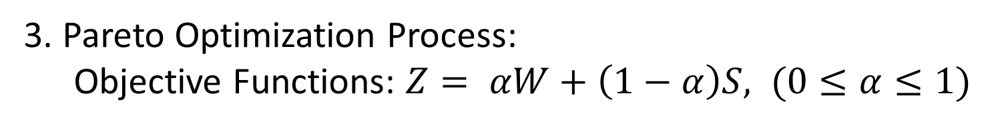
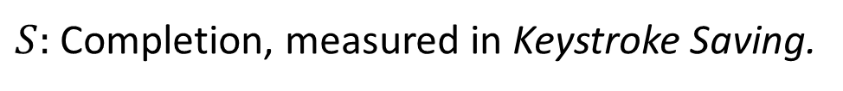
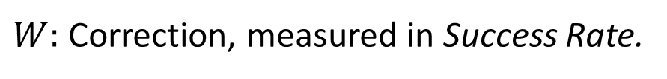
Multi-Objective Optimization of Keyboard Algorithm
3. Pareto Optimization Process:
Objective Functions: $Z= αW+\left(1−α\right)S, (0≤α≤1)$
$W:$ Correction, measured in Success Rate.
$S:$ Completion, measured in Keystroke Saving.

Slide 21



Multi-Objective Optimization of Keyboard Algorithm
3. Pareto Optimization Process:
Objective Functions: $Z= αW+\left(1−α\right)S, (0≤α≤1)$
$W:$ Correction, measured in Success Rate.
$S:$ Completion, measured in Keystroke Saving.
$$P_{w}: α=1$$
$$P_{S}: α=0$$
$$P_{S+W}: α=0.5$$

Slide 22
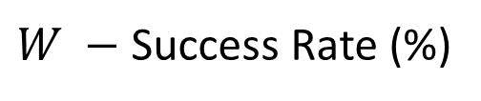
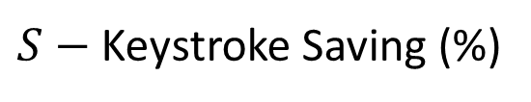



Pareto Frontier
$S−$Keystroke Saving (%)
$$P_{S}$$
$$P_{W+S}$$
$$P_{W}$$
$W −$Success Rate (%)

Slide 23






Pareto Frontier
$S−$Keystroke Saving (%)
$W$: 81.7%
$S$: 38.3%
$$P_{S}$$
$W$: 88.0%
$$P_{W+S}$$
$S$: 37.3%
$W$: 88.4%
$$P_{W}$$
$S$: 30.9%
$W −$Success Rate (%)

Slide 24




Examples of Correction and Completion
Typed Word
$$P_{w}$$
$$P_{S}$$
$$P_{W+S}$$
agsim
again
agsim
again

Slide 25
Examples of Correction and Completion
Typed Word
$$P_{w}$$
$$P_{S}$$
$$P_{W+S}$$
agsim
again
agsim
again
quivj
quick
quivj
quick

Slide 26
Examples of Correction and Completion
Typed Word
$$P_{w}$$
$$P_{S}$$
$$P_{W+S}$$
agsim
again
agsim
again
quivj
quick
quivj
quick
fav
fav
favorite
favorite

Slide 27
Evaluation
Test Dataset: 24 users, 40 phrases/user

Slide 28



Evaluation
Test Dataset: 24 users, 40 phrases/user
Success Rate
(%)
$$P_{W+S}$$
$$P_{S}$$
$$P_{W}$$

Slide 29



Evaluation
Test Dataset: 24 users, 40 phrases/user
Success Rate
Keystroke Saving
(%)
(%)
$$P_{W+S}$$
$$P_{S}$$
$$P_{W}$$
$$P_{W+S}$$
$$P_{S}$$
$$P_{W}$$

Slide 30



Conclusions
Correction and completion capabilities have only a minor conflict with each other.
Completion (%)
$$P_{S}$$
$$P_{W+S}$$
$$P_{W}$$
Correction (%)

Slide 31


Conclusions
Correction and completion capabilities have only a minor conflict with each other.
Completion (%)
$$P_{S}$$
$$P_{W+S}$$
$$W=88.0\%, S=37.3\%$$
$$P_{W}$$
Correction (%)
Pareto optimization is effective in improving
both capabilities.
$$P_{S}{, P}_{W}{, P}_{W+S}$$

Slide 32
Summary
Qwerty-Bounded Keyboard Layout Optimization
Multilingual Keyboard Layout Optimization
Keyboard Layout Optimization for Gesture Typing
Multi-Objective Optimization for Decoding Algorithm

